Slide 1
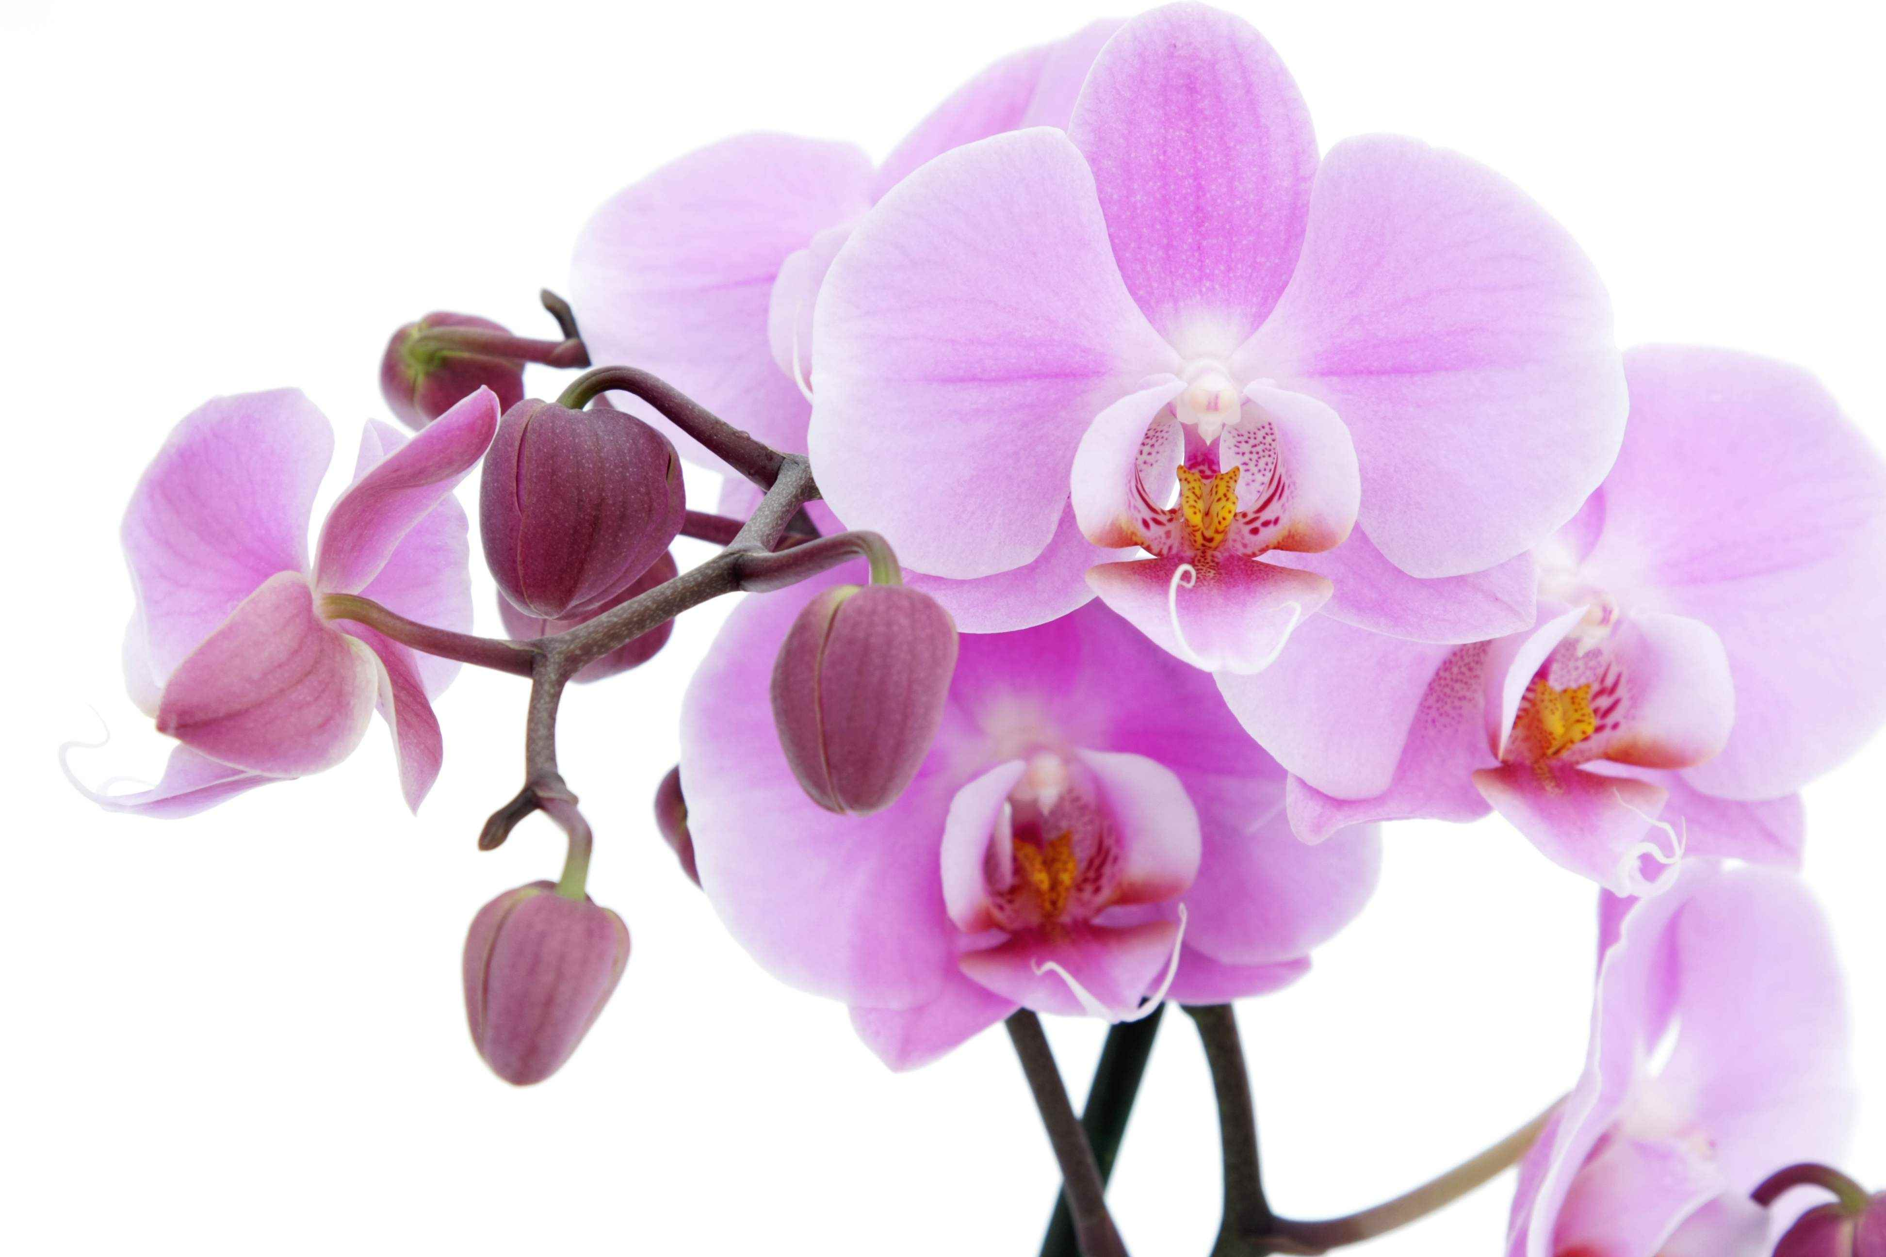
Welcome

Slide 2
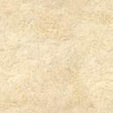
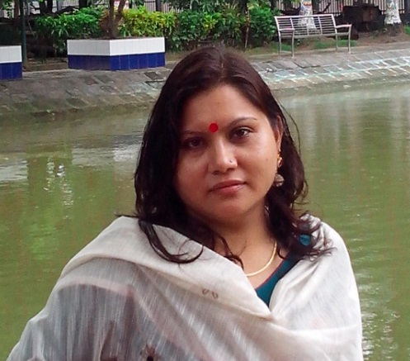
INTRODUCTION
_
Mst: FarhanaHaque_
Asst:Teacher(computer)
Babukha High School,
Rangpur.
haquefarhana@ymail.com
Sub: English(1st paper)
Class :Eight.
Time:40 minutes
Date:10/02/2014

Slide 3
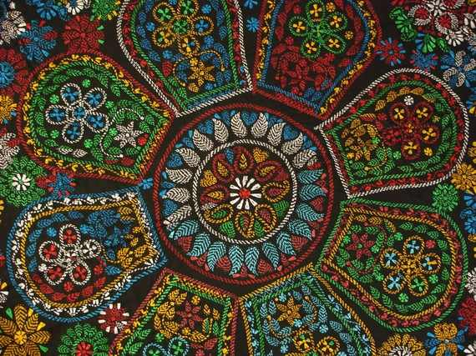
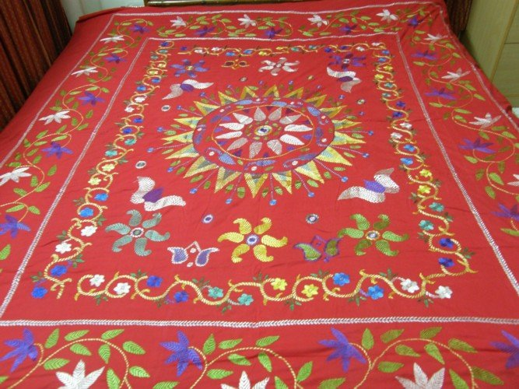
What do you see in the picture?
What is it called?

Slide 4
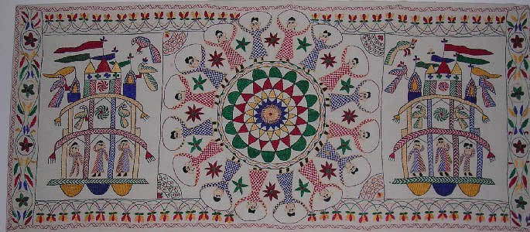
Nakshi Kantha

Slide 5
Learning outcomes:
Students will be able to :
read & understand the text.
understand the vocabs
quilt, artistic,commercially,traditional,,pattern.
ask & answer questions
write a short paragraph
fill the blanks
practice passive voice.

Slide 6

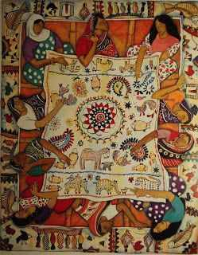
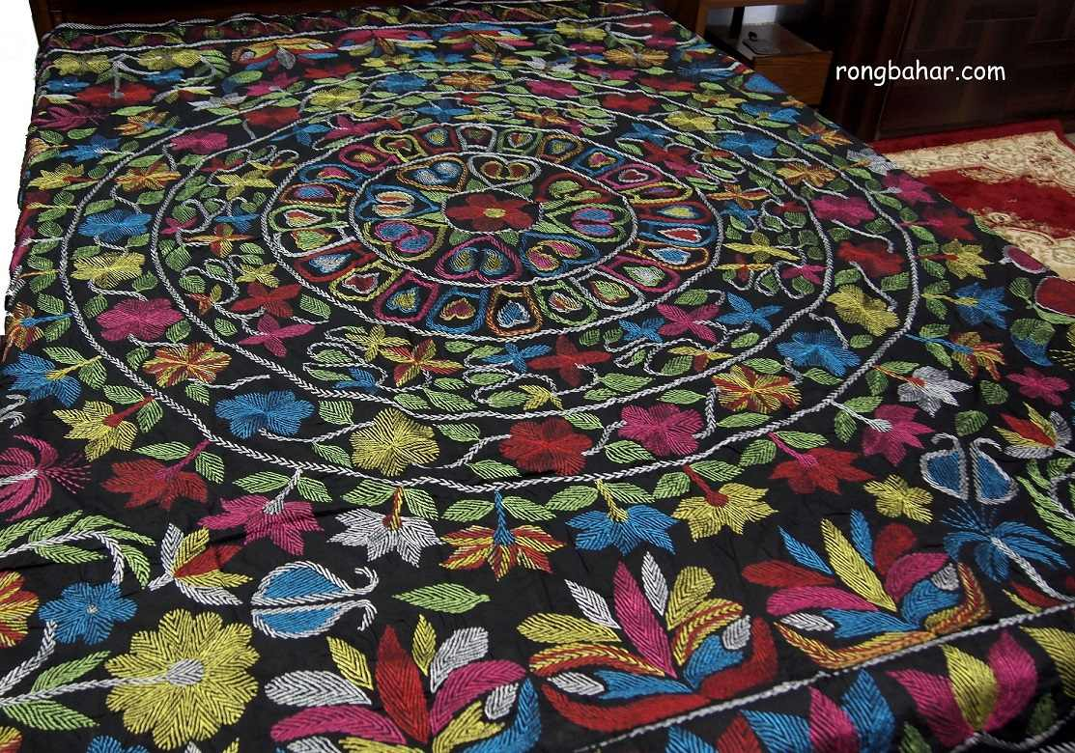
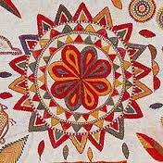
Have you seen it before? where?
What do you do with it?

Slide 7

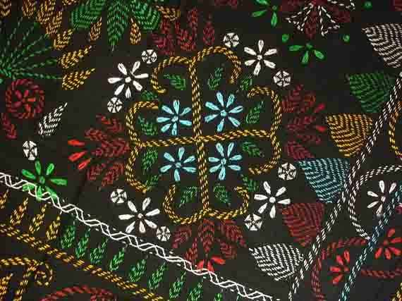
Vocabulary
Quilt:
a bed covering consisting of two of fabric stitched together
Artistic:
Having or revealing creating style.

Slide 8
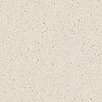
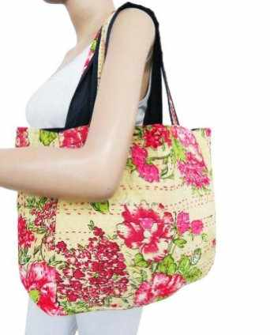

An advertisement in a common media format
Commercially:
Traditional:
Pattern:
Attached to old custom
decorative arrangement

Slide 9
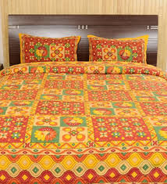
Nakshi kantha is a kind of embroidered quilt.

Slide 10

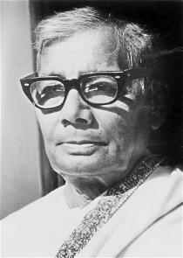
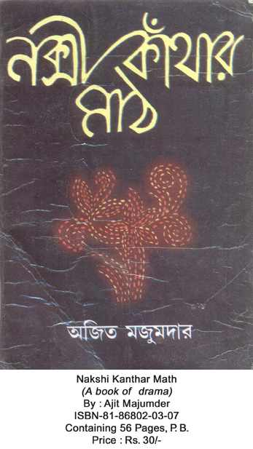
Jasimuddin
The name Nakshi kantha become famous after the poet Jasimuddin’s poem Nakshi kanthar Math was published in 1929.

Slide 11
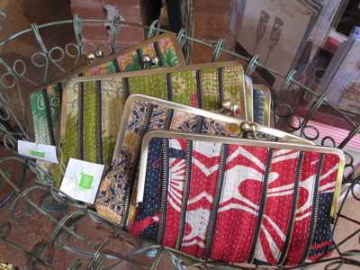
Traditional Kanthas are made for family use. Old or new cloth and thraed are used to make this quilt. Mymensing
Jamalpur, Rajshahi, Faridpuir Bogra and Jessor are most famous for this craft.
Now it is produced commercially. We find them in many expensive handicraft shops in cities. The quilts are now in great demand.

Slide 12
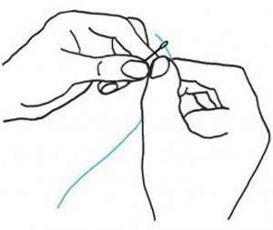
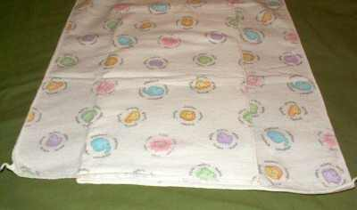
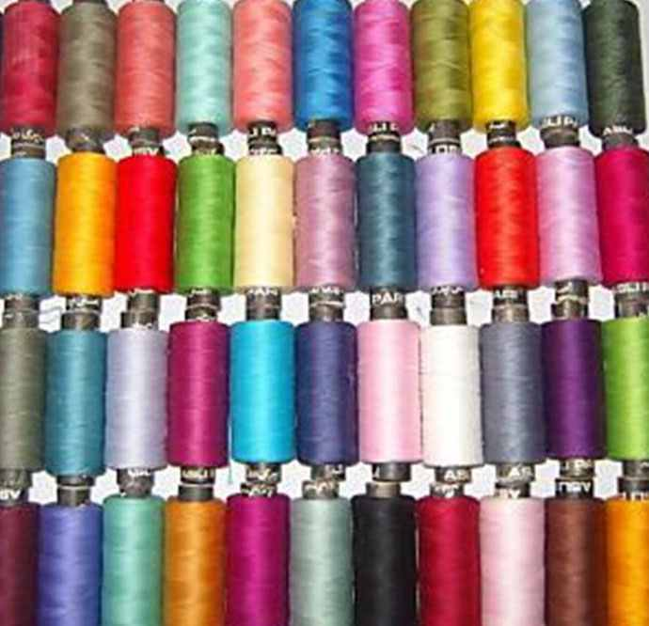
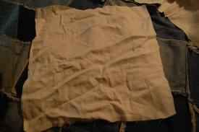
To make a nakshi kantha we need
Needle
New cloth
Old cloth
Colorful thread

Slide 13

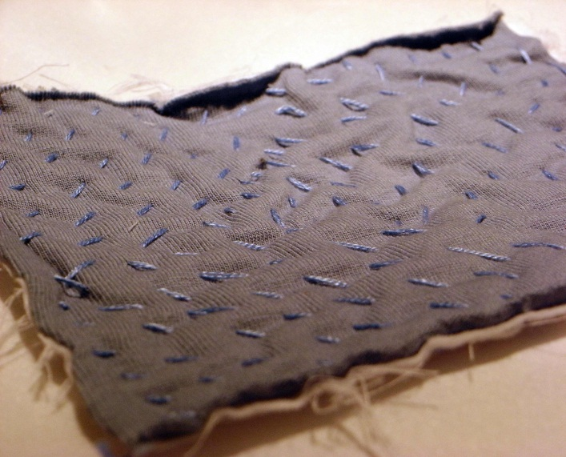
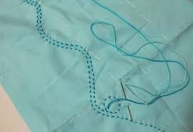
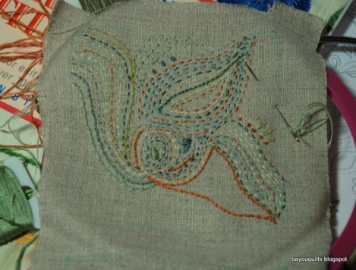
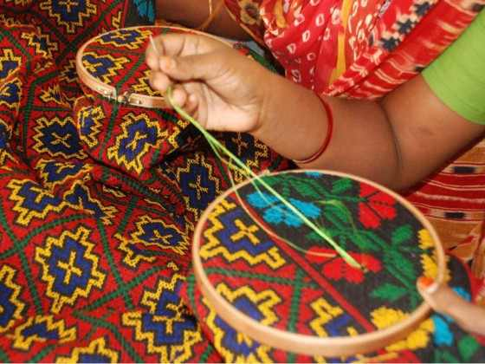
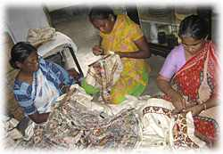
The process of making Nakshi kantha
Step 1
Step 2
Step 3
Step 4
Step 5
Step 6

Slide 14

Group work
Write a short paragraph describing how the Nakshi kantha is made . Start like this: Old and new cloth and colored thread are needed . First the cloth is folded……………………

Slide 15
Bengali,patterns,embroidery,years,fashion,art,rural,designs,quilt, noksha.
Now read the text individually and complete the sentences with clues given below:
design
Naksha means artistic …………… .
The name was taken from a ……..word…….. …
The art has been practiced in………Bengal.
Nakshi kanthas are now sold in ……….shops.
Nakshi kanthas are a kind of …………
Nakshi kanthas are in great demand because of their colorful……………and …………
Bengali
naksha
west
fashion
quilt
embroidery
design

Slide 16
Grammar
In passive voice preference are given in object in the place of subject.
Structure:
Examples:sub+aux(verb)+past perticiple+ext(by+obj)
Rural Bengal has practiced the art.
Passive: The art has been practiced in rural Bengal.
These quilts use to make old or new cloth and thread.
Passive: old or new cloth and thread are used to make these quilts.

Slide 17

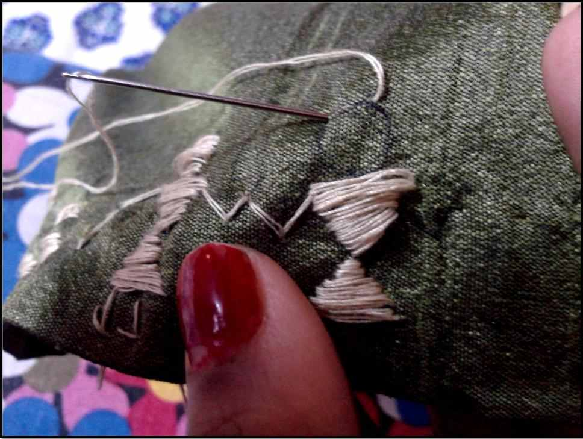
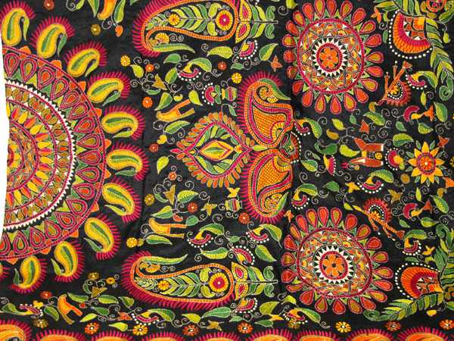
Evaluation
Who is he?
Tell what is happening in 1,2 & 3 no picture?
1
2
3

Slide 18

Home work
Do you like a nakshi kantha or an ordinary kantha? Why?

Slide 19


